Slide 1
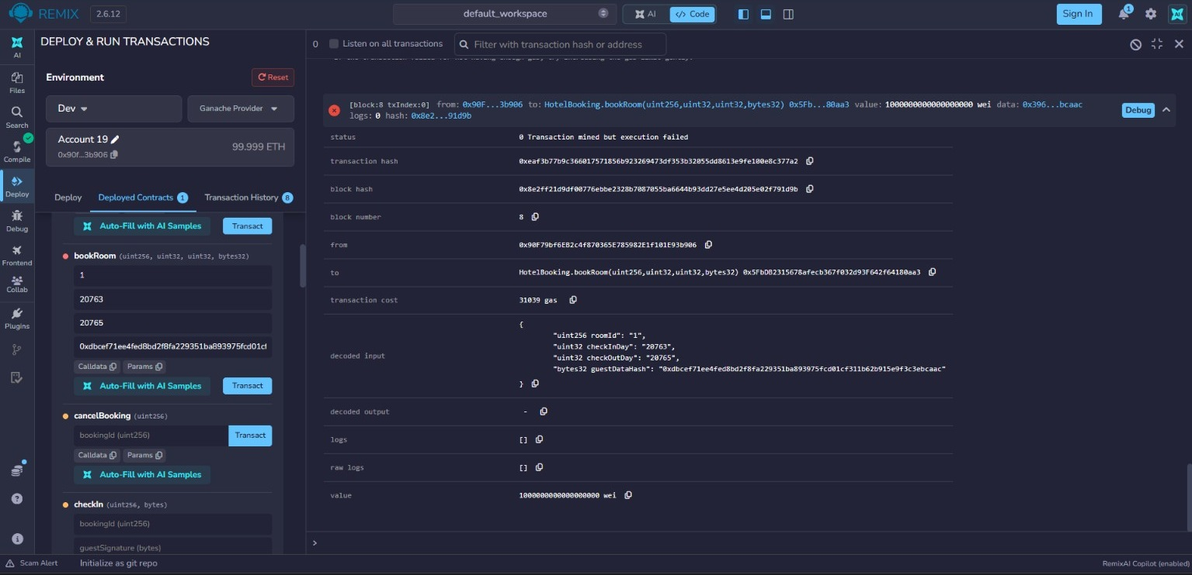
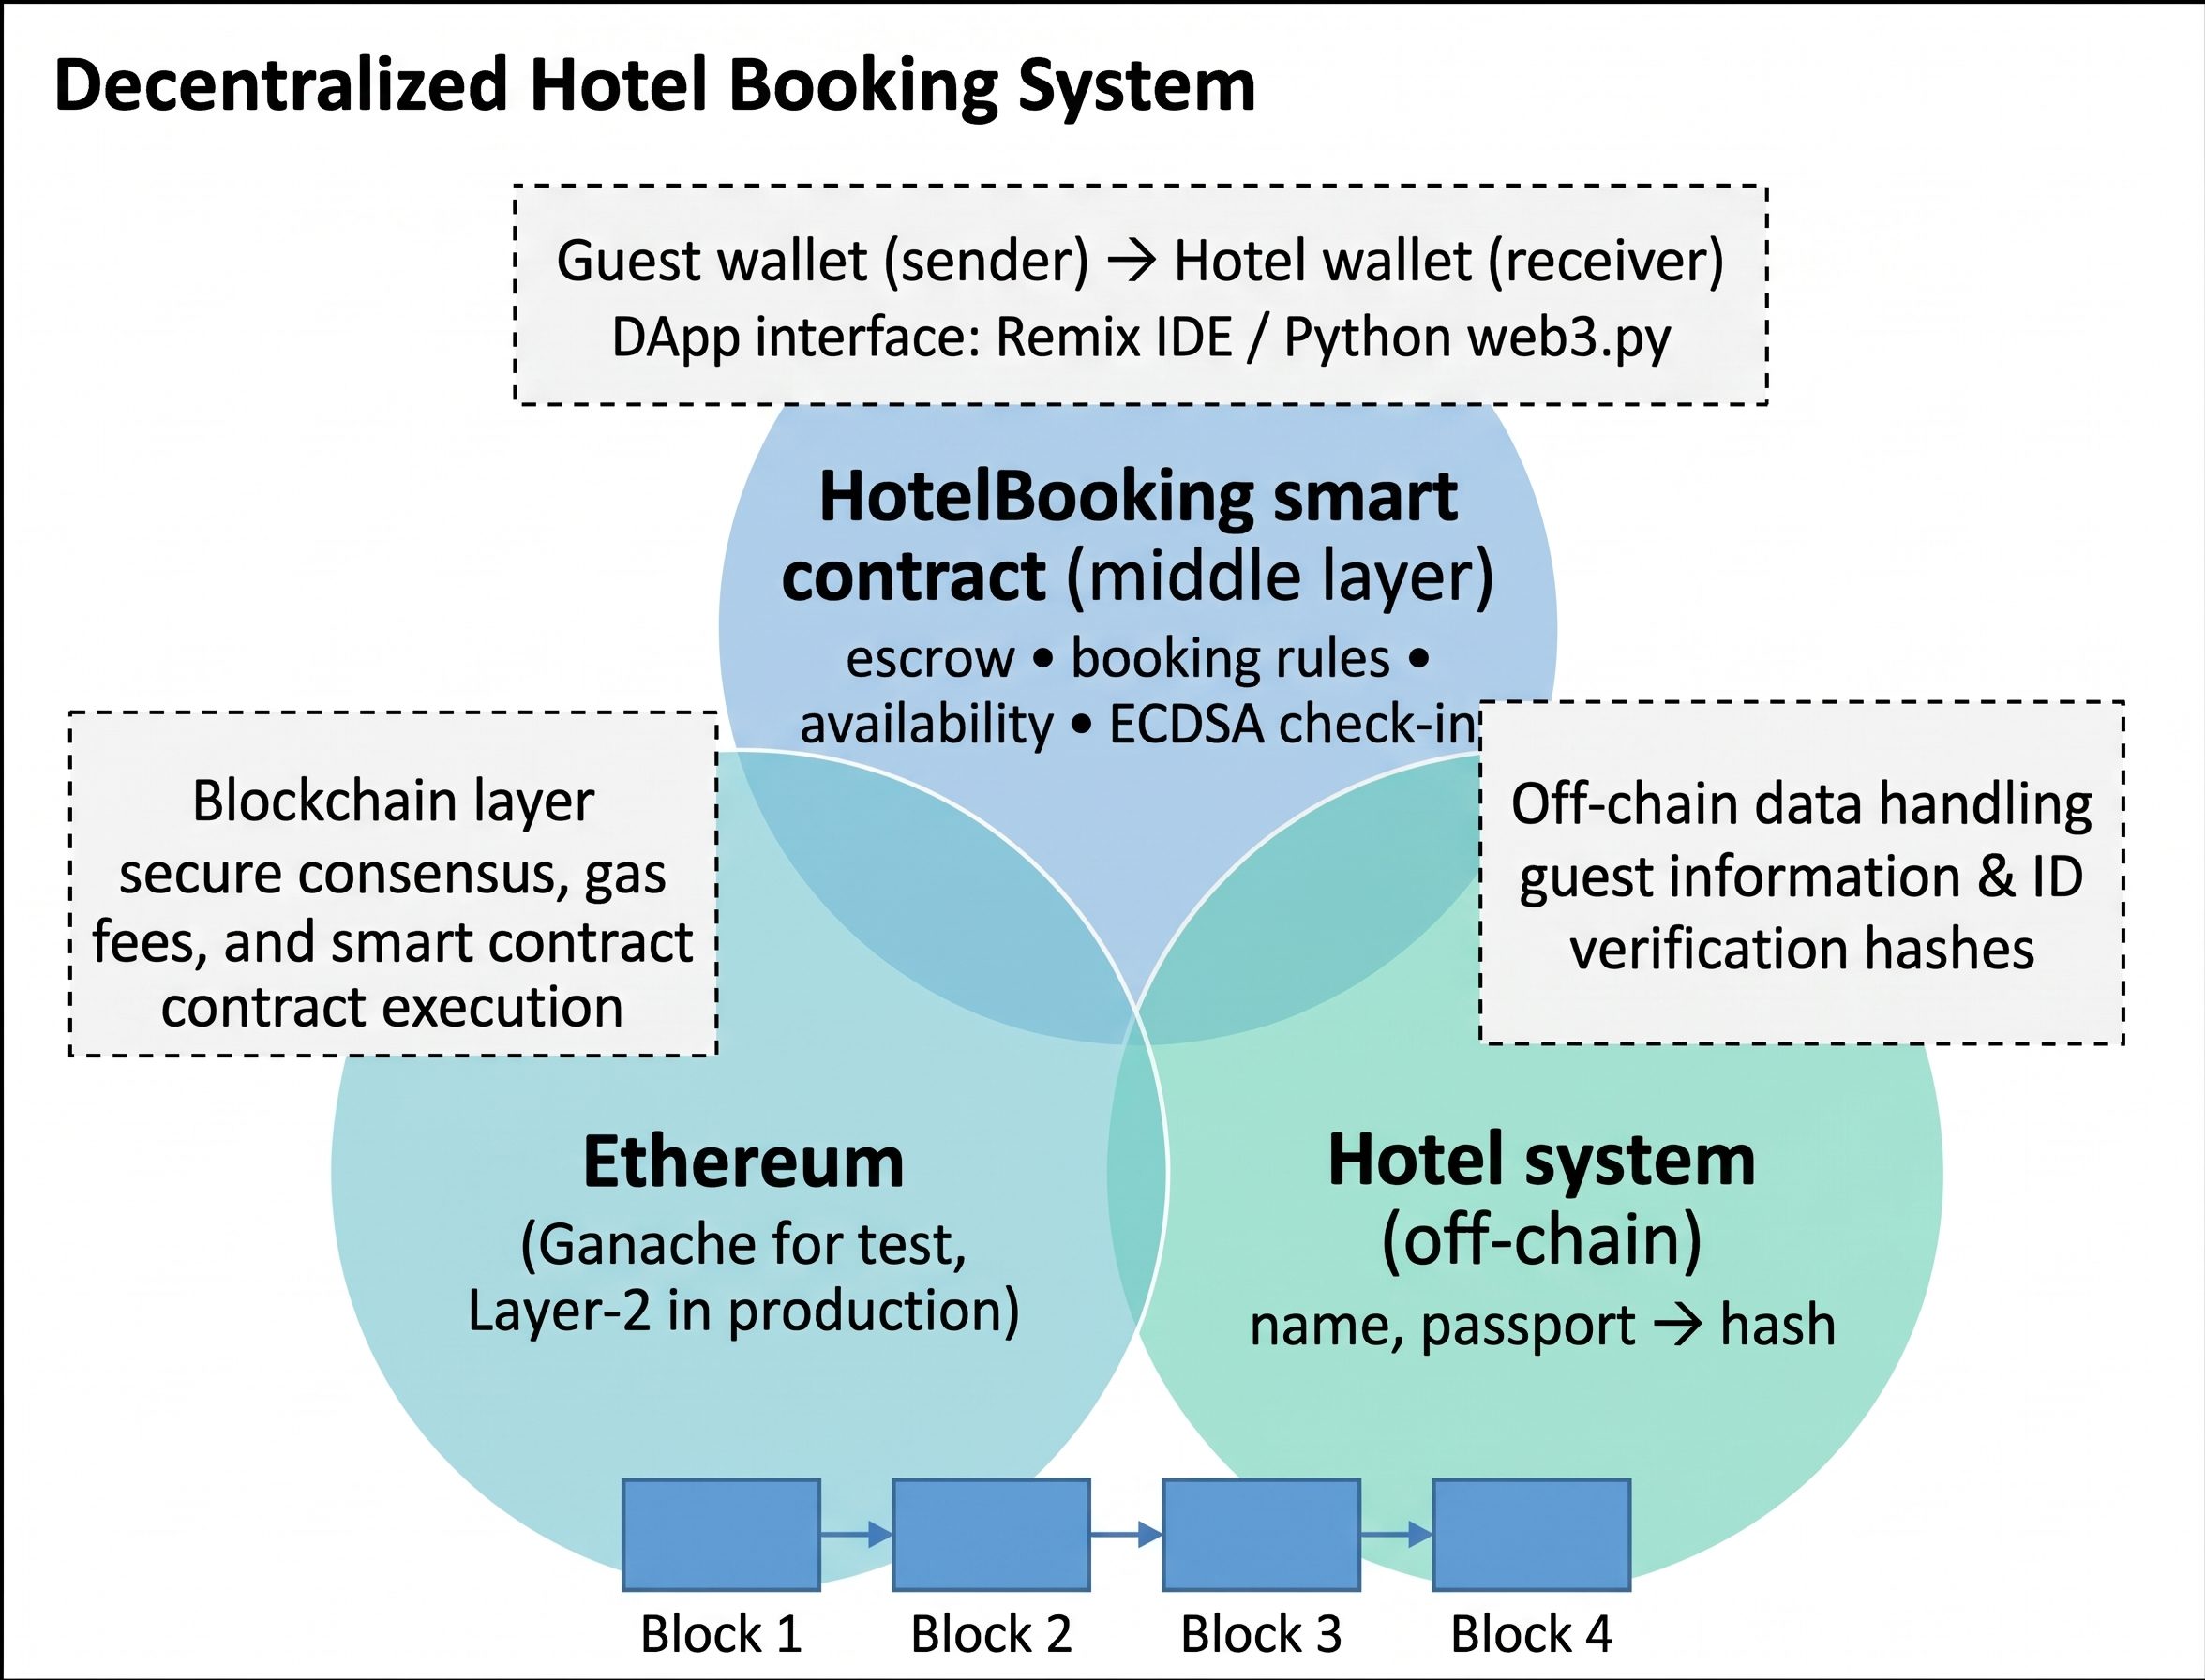
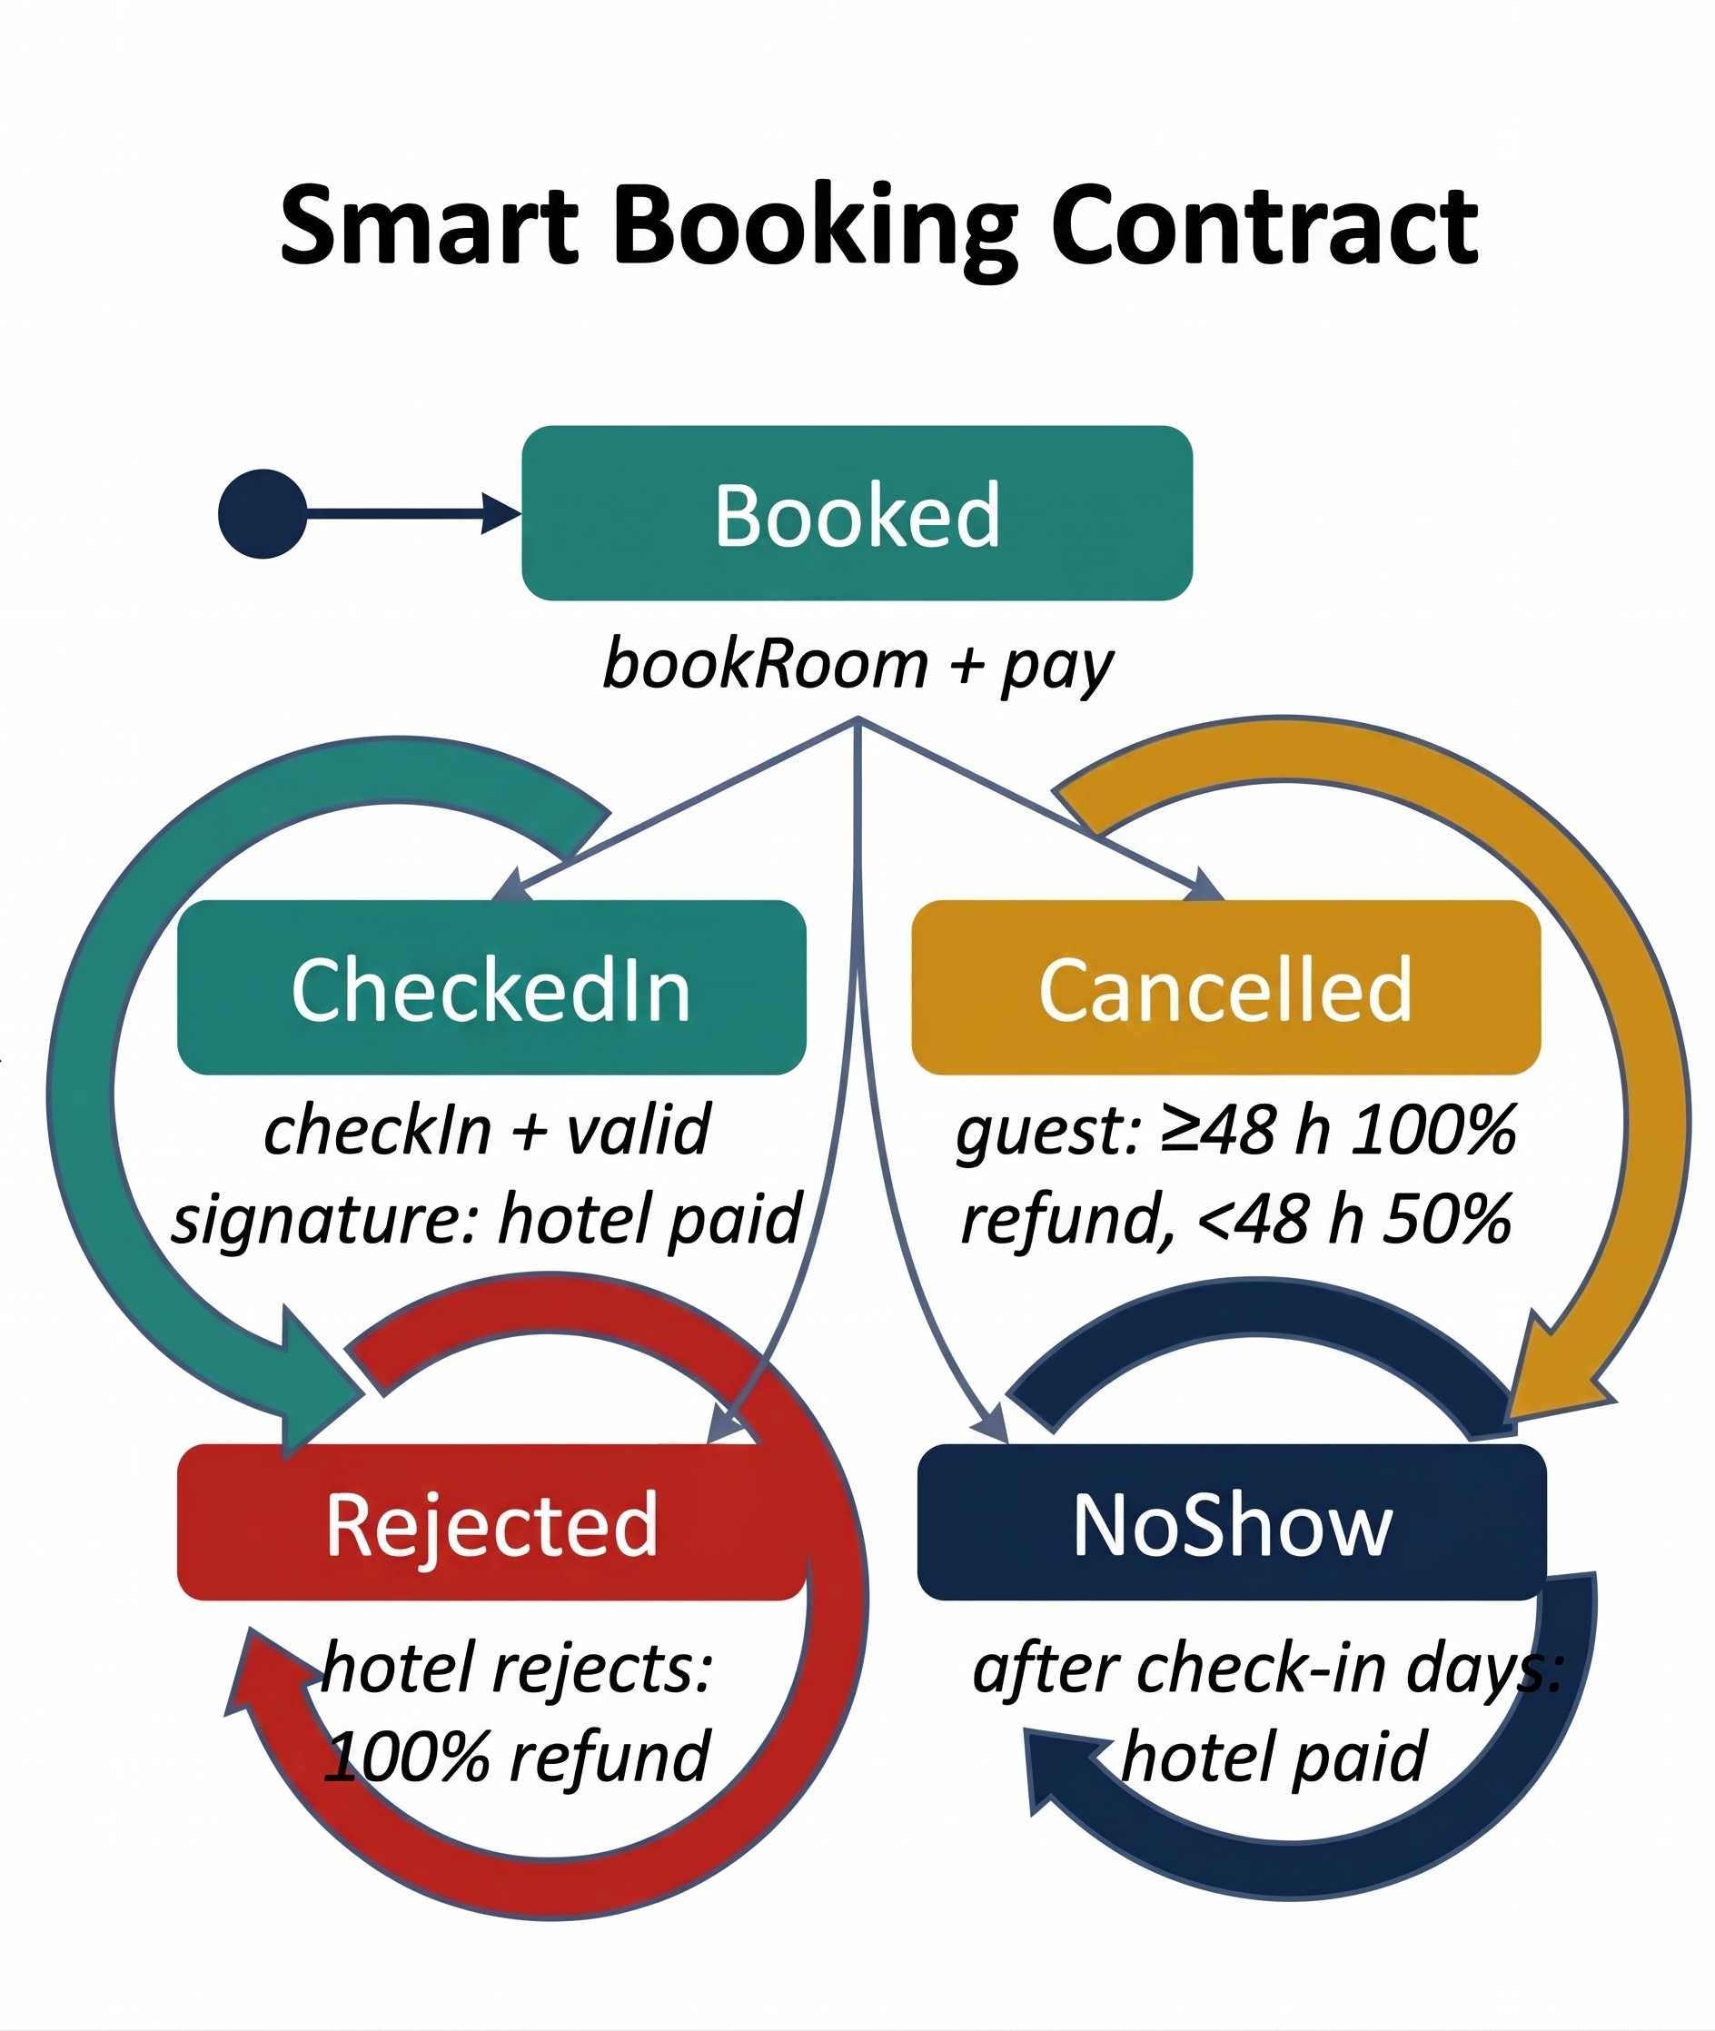
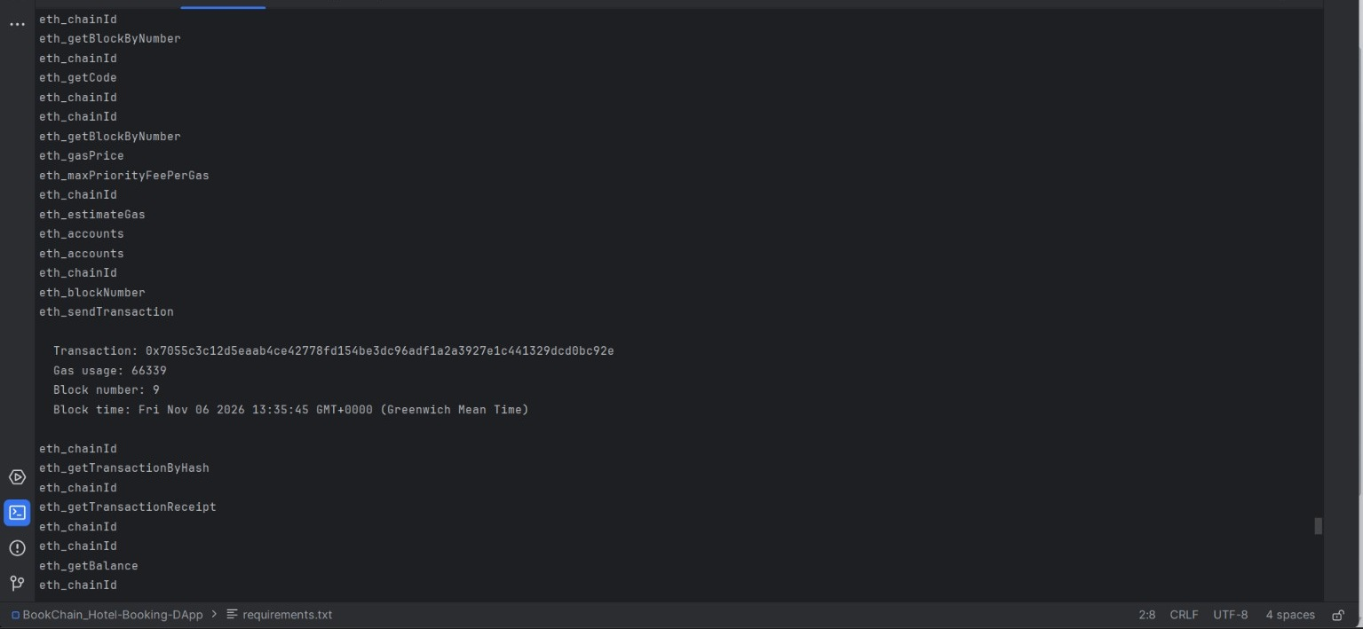
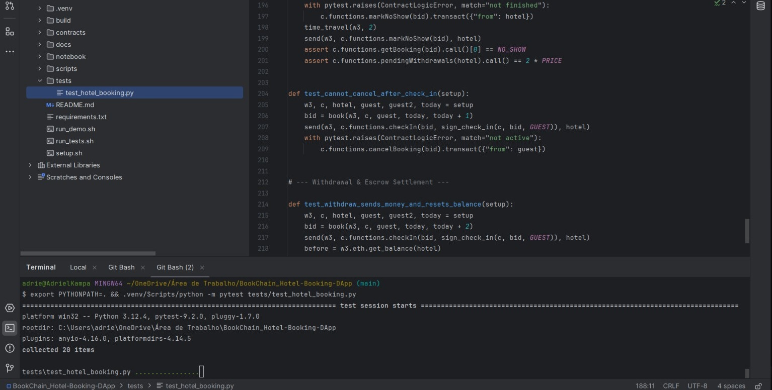
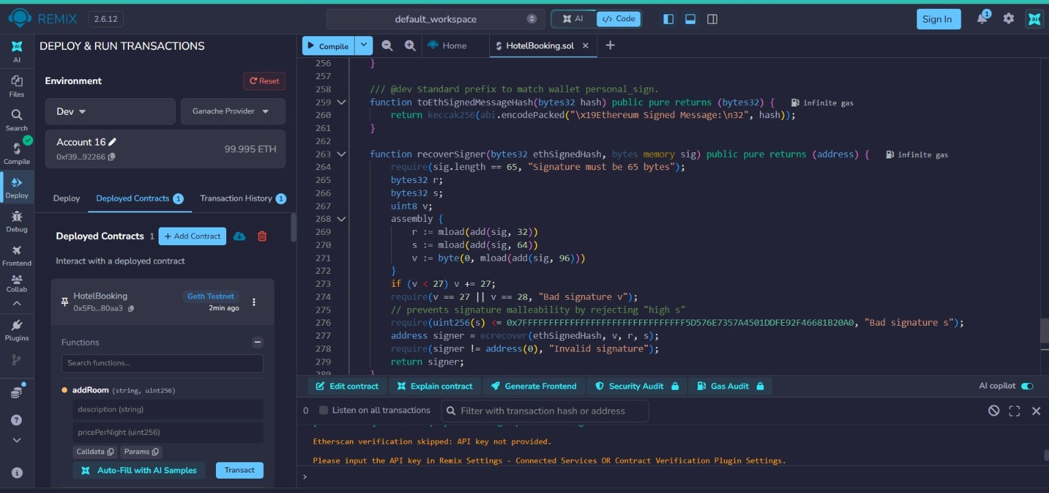
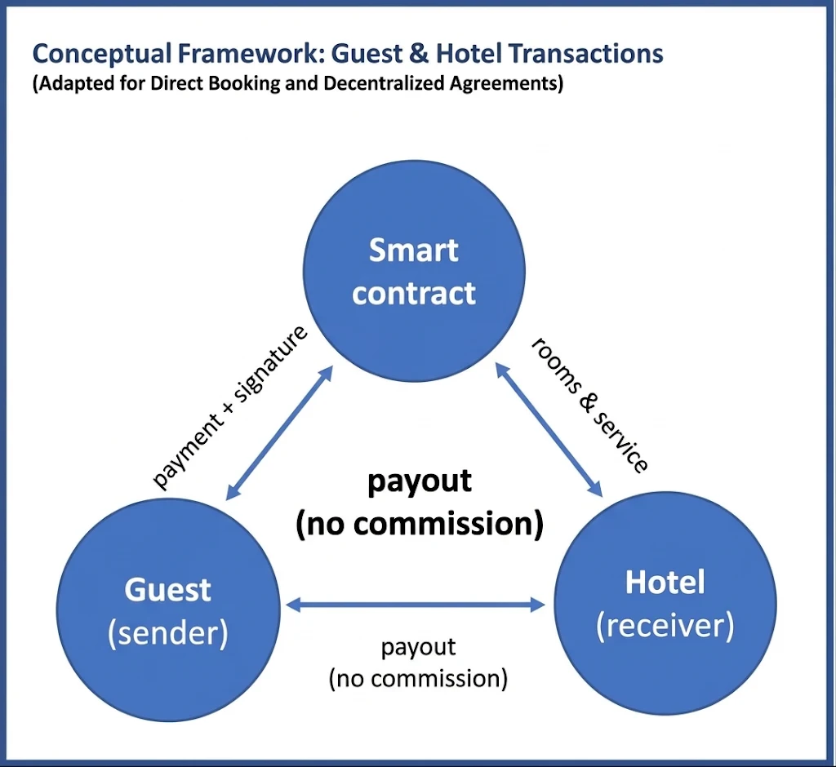
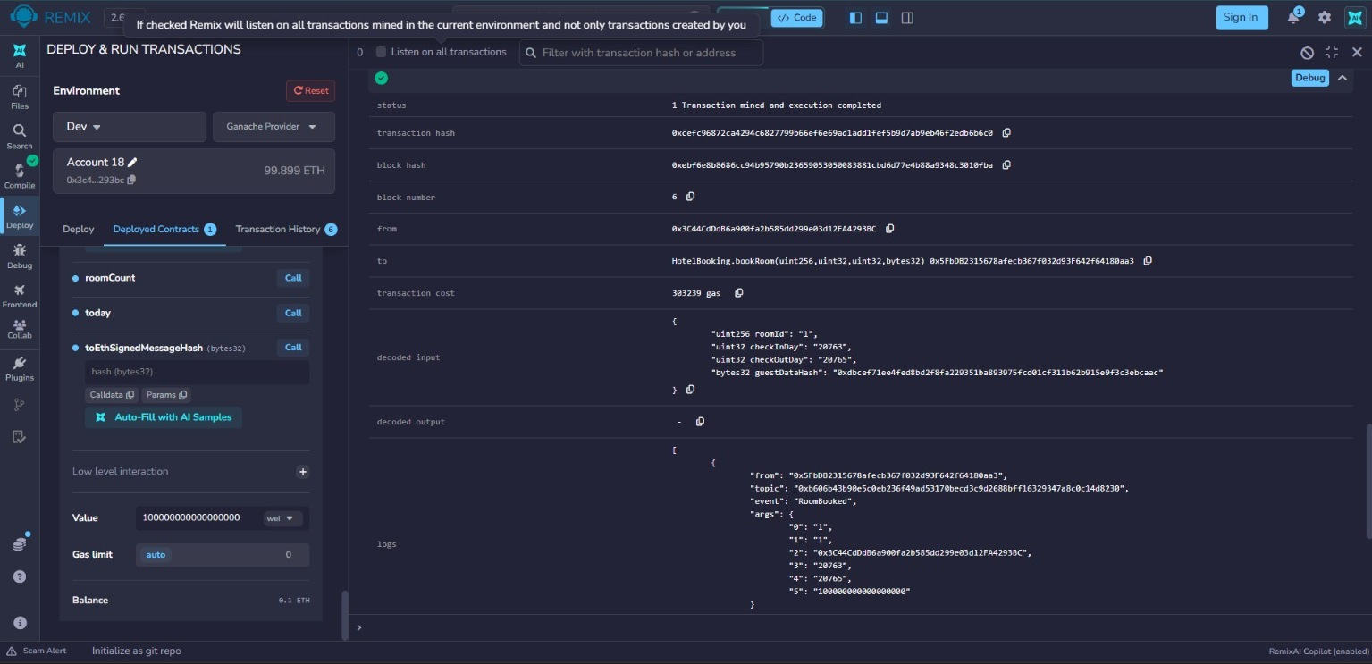
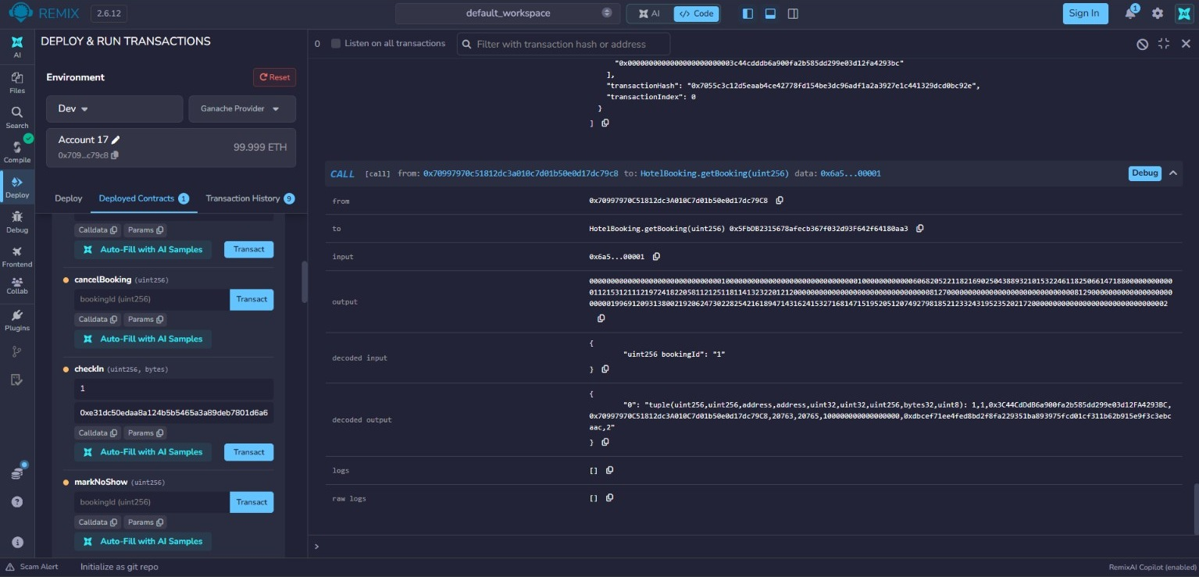
BookChain: A Blockchain-Based Hotel Booking DApp with Smart-Contract Escrow
Distributed Digital Transactions – CA1
Github: https://github.com/AdrielCCT/BookChain_Hotel-Booking-DApp
Student: Adriel Kampa de Gois Student Number: 2024378
GoogleDrive:
Lecturer: Dr. Muhammad Lqbal
THE PROBLEM
PROPOSED SOLUTION
function getCheckInMessageHash(uint256 id)
public view returns (bytes32) {
return keccak256(abi.encodePacked(
address(this), block.chainid, id,
"CHECK-IN"));
}
// inside checkIn(bookingId, guestSignature)
require(recoverSigner(h, guestSignature)
== b.guest, "Invalid guest signature");
Most hotels rely on online travel agencies (OTAs) for room sales. The OTA retains the payment, sets their own cancellation policies, and charges a commission. It leads to overbookings as availability is duplicated among various platforms, and each system has a different process for refunds. BookChain is an alternative, with smart contracts that connect guests and hotels, replacing the middleman (Önder and Treiblmaier, 2018).
Guest (sender) and hotel (receiver) use HotelBooking as a middle layer for all blockchain interaction. The payment stays with HotelBooking as do all the rules and conditions. The hotel doesn't know who made the reservation until it happens, and then it is able to fulfill the reservation and release the payment to itself. Personal data is never put on-chain. Only the hash of the personal data is.
Figure C: ECDSA check-in – escrow is released only with the guest's signature
 | Traditional OTA | BookChain
Payment | Held by OTA / hotel | Smart-contract escrow
Cancellation | Platform rules, manual refund | Coded rules, automatic refund
Availability | Many databases | One shared ledger
Cost | Commission per booking | Network gas fee
Trust | Trust the company | Public, auditable code
Guest data | Copied to every system | Only a hash on-chain
SMART CONTRACT DESIGN
HotelBooking.sol (Solidity 0.8.20): the hotel lists rooms, the guest books them. Payments use the pull pattern (withdraw) with a re-entrancy guard; every state change emits an event.
Fig4: Revert: a second booking of the same nights (block 8) fails with execution reverted.
DISRUPTIVE INFLUENCE
Eliminating middlemen: Hotels will be able to sell to guests and guests will keep the security of paying OTA.
Smart policies: Automation of cancellations and no-show payments.
Verified records: Every transaction will be unique so a night cannot be sold multiple times. (Zheng et al., 2017)
New way of generating revenue: The gas fees will be used in place of commissions..
Figure B: Architecture – blockchain as the middle layer
RECENT ADVANCEMENTS
Payments and cancellations see the most disruption with this approach. Because room inventory and identity verification still operate largely off-chain, BookChain does not displace hotel management software but rather supplements it.
Rollups of Layer-2 and EIP-4844 (Dencun, 2024): By lowering the cost of data on rollups, rollup users are able to conduct low-value transactions (Buterin et al., 2022).
Account abstraction (ERC-4337, EIP-7702): Thanks to a paymaster, the guest is not required to pay gas with ETH (Buterin et al., 2021; 2024).
Verifiable Credentials 2.0: By allowing the guest to prove their identity with Verifiable Credentials 2.0, the guest does not have to provide a copy of their passport at check-in (W3C, 2025).
Stablecoins: In the future, guests may pay with stablecoins to avoid volatility of ETH.
Fig5: Ganache: RPC log and demo-script output (transaction hash, gas used, block 9).
IMPLEMENTATION AND TESTING
CONCEPTUAL FRAMEWORK
Built with Solidity 0.8.20 in Remix IDE, a Ganache local chain,
Python (web3.py, py-solc-x, pytest)
and Bash scripts.
Procedure: follow figures 1 to 6.
The conceptual framework below, was developed from Bandura’s (1986) Reciprocal Determinism model, in which Behaviour, Environmental Factors and Personal Factors were replaced with Self-Efficacy, Social Learning and Reflection, which became the basis for developing implementation strategies to enhance student engagement.
BENEFITS AND CHALLENGES
Benefits
No OTA commission
Escrow protects the guest's money
Automatic, instant refunds
No double booking
Tamper-proof audit trail
Challenges
Gas fees and speed on mainnet (L2 helps)
Wallets are hard for ordinary guests
GDPR erasure vs immutable data (European Union, 2016)
Bugs are hard to fix: audit first
Oracle problem: proving the guest arrived
Fig6: Test: pytest collects and runs the 20 contract tests.
Fig1:Deploy:Ganache provider (0x5Fb…80aa3); ECDSA recovery code in the editor.
CONCLUSIONS
The smart contract has demonstrated the capability of an Online Travel Agent (OTA). The smart contract is capable of performing holding the funds and implementing rules for both double booking and authorized funds release. Further, it uses the ECDSA signing for payment release to verify the guest, hence providing a secured payment gateway. Limitations: The smart contract is still in the testing phase using a local Ganache network. Further developments: An L2 network integration, front-end with MetaMask, and a stable coin payment option.
CRYPTOGRAPHIC METHOD
ECDSA with the secp256k1 curve and Keccak-256 is the method that I’ll use for this project because this is what Ethereum currently uses for accounts. The scheme also meets my needs (Johnson, Menezes and Vanstone, 2001; Wood, 2014).
Authentication and Non-repudiation: A guest signs a message when they check in and ecrecover gets the message signer for me. This allows only the real guest to sign off and let the payment get released.
Integrity: A booking ID and chain ID and a contract address will be signed as part of the message to help avoid signature replays, and any signature with an s value too high will be rejected.
Confidentiality: Hashing salted passport and name is all I’ll store on-chain.
Why Not AES or RSA: For AES, it would require shared secrets between strangers, which would defeat my needs. For RSA, it would need 3072-bit keys for the same 128-bit security, and I’d lose the benefits of having ecrecover (unlike RSA, there is no verifier in RSA).
Fig2: Book: bookRoom succeeds in block 6; 0.1 ETH is sent and a RoomBooked event is logged.
Figure A: Business model – the contract replaces the OTA as trusted party
REFERENCES
Fig3: Check in: getBooking returns guest, hotel, dates, amount, data hash and status 2.
Buterin, V. et al. (2021) ERC-4337: Account Abstraction Using Alt Mempool. Available at: https://eips.ethereum.org/EIPS/eip-4337
Buterin, V. et al. (2022) EIP-4844: Shard Blob Transactions. Available at: https://eips.ethereum.org/EIPS/eip-4844 Buterin, V., Wilson, S., Dietrichs, A. and lightclient (2024) EIP-7702: Set Code for EOAs. Available at: https://eips.ethereum.org/EIPS/eip-7702
European Union (2016) Regulation (EU) 2016/679 (General Data Protection Regulation), Official Journal of the European Union, L 119, pp. 1–88.
Johnson, D., Menezes, A. and Vanstone, S. (2001) 'The Elliptic Curve Digital Signature Algorithm (ECDSA)', International Journal of Information Security, 1(1), pp. 36–63.
Önder, I. and Treiblmaier, H. (2018) 'Blockchain and tourism: Three research propositions', Annals of Tourism Research, 72, pp. 180–182.
W3C (2025) Verifiable Credentials Data Model v2.0. Available at: https://www.w3.org/TR/vc-data-model-2.0/ Wood, G. (2014) Ethereum: A secure decentralised generalised transaction ledger. Available at: https://ethereum.github.io/yellowpaper/paper.pdf
Zheng, Z., Xie, S., Dai, H., Chen, X. and Wang, H. (2017) 'An overview of blockchain technology: Architecture, consensus, and future trends', IEEE International Congress on Big Data, Honolulu, 25–30 June, pp. 557–564.

